Slide 1
EcoTrack- Your Personal Sustainability Companion
How can we reduce carbon footprints
Solutions
Methods
Community
Track activity

Slide 2
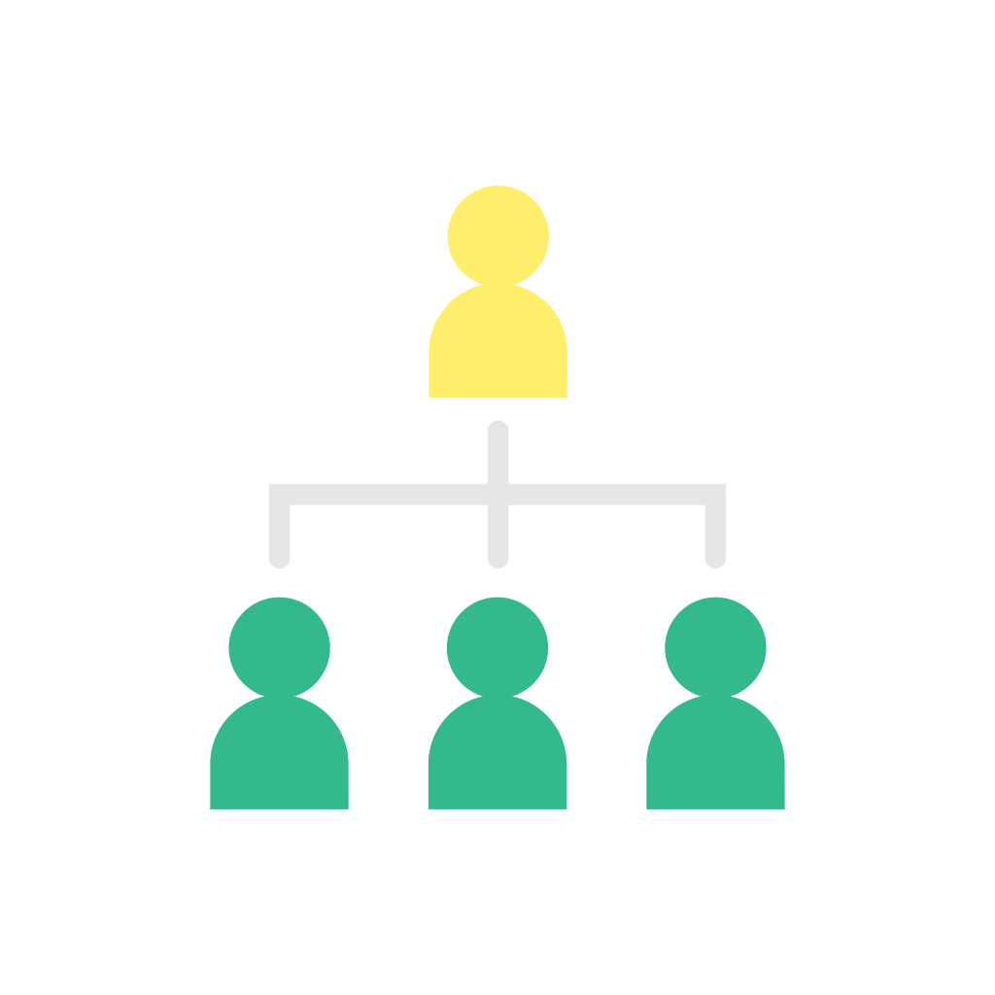
Our Team
Likuna Pradhan
Megha Anjana
Sudhanshu Sekhar Naik
Bikash Naik

Slide 3
Table of contents
1)PROBLEM STATEMENT | 2)INTRODUCTION
3)WHY WE CHOOSE THIS PROJECT? | 4)AIM OF THE PROJECT
5)FEATURES | 6)SITE MAP
7)TECHNOLOGIES | 8)END

Slide 4
Problem Statement
Despite growing awareness of environmental issues and the desire of many individuals to contribute to sustainability, there is a significant gap in tools that provide effective, user-friendly means of tracking and reducing personal carbon footprints. Many existing solutions are either too complex, not comprehensive or lack the personalization needed to make a real impact. This gap hinders collective efforts to combat climate change and promote sustainable living.
EcoTrack addresses this challenge by offering a holistic, user-friendly platform that tracks daily activities, suggests personalized sustainability tips, and visualizes progress. By making sustainability accessible and actionable, EcoTrack empowers users to make informed decisions and take meaningful actions toward reducing their environmental impact

Slide 5
INTRODUCTION
EcoTrack is an online tool made to help people track, comprehend, and lessen their carbon footprints.
The project aims to encourage sustainable living and contribute to global environmental efforts. It is in line with the Sustainable Development Goals (SDGs) 12 (Responsible Consumption and Production) and 13 (Climate Action).

Slide 6

Why we choose this project?
This need is met by EcoTrack, which offers a feature-rich platform that allows users to log their everyday activities, get individualized sustainability advice, and see their development over time
The need for individual responsibility and practical steps towards sustainability grows as climate change continues to pose a serious threat to our planet.

Slide 7
Aim of project
Empower individuals by providing easy access to tools and resources that help them understand and reduce their carbon footprints.
Provide tailored tips and recommendations that promote sustainable living practices.
Develop a platform for eco-conscious users to share experiences, collaborate, and support each other on their sustainability journeys.
Align with SDGs 12 and 13 to contribute to global efforts in promoting responsible consumption and combating climate change.

Slide 8
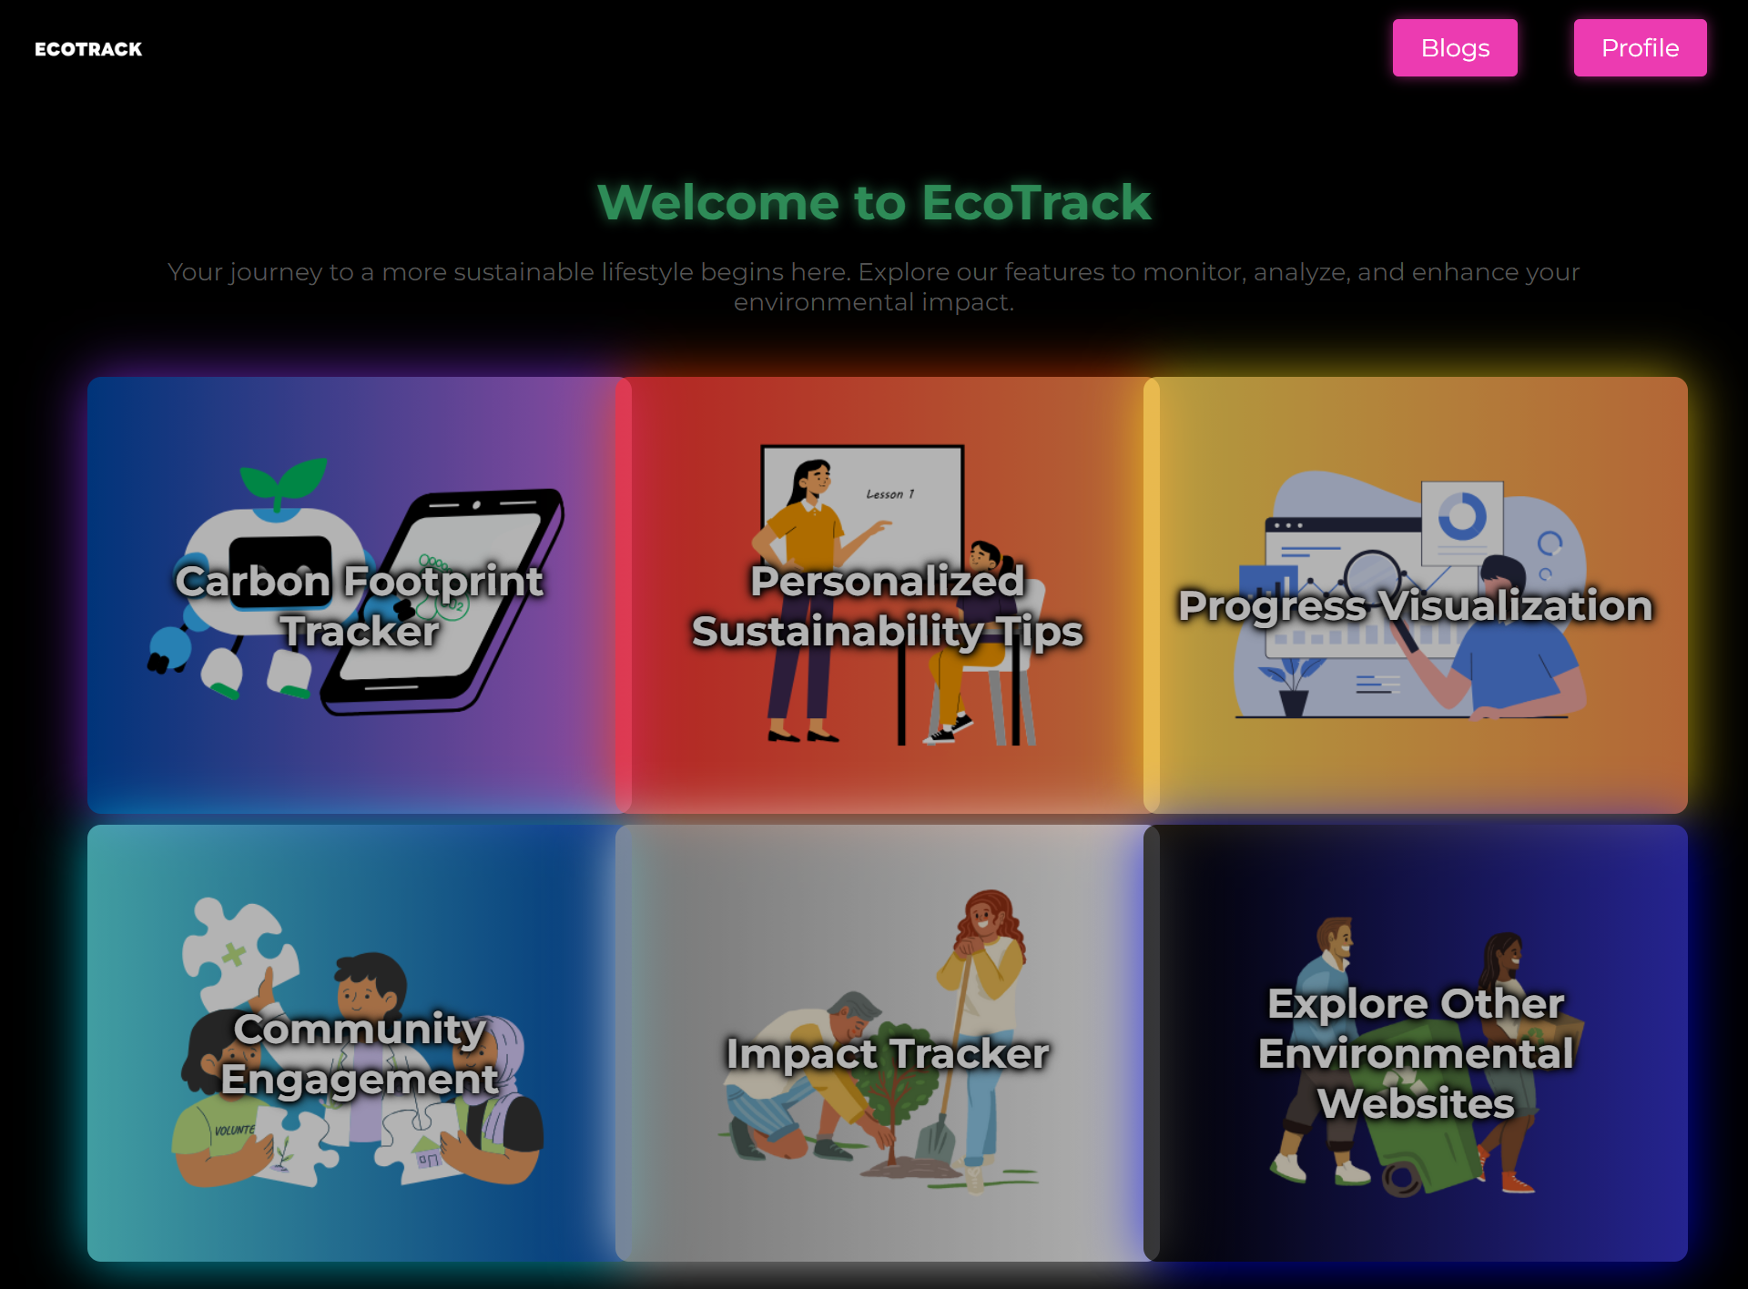
Features
User Registration and Login:Personalized profiles ensure secure user authentication.
Daily Activity Tracking:Calculate and present the results of carbon emissions to users, using activity data.
Personalized Tips:Apply artificial intelligence models to examine user information and produce tailored suggestions.
. Data Visualization: Utilize diagrams and illustrations to depict trends in carbon emissions and advancements throughout history
.
Community Forum:Develop a platform for a community where members can talk about environmental issues, seek advice, and exchange advice.
Impact Tracker:Display the cumulative environmental impact of individual and community actions.

Slide 9
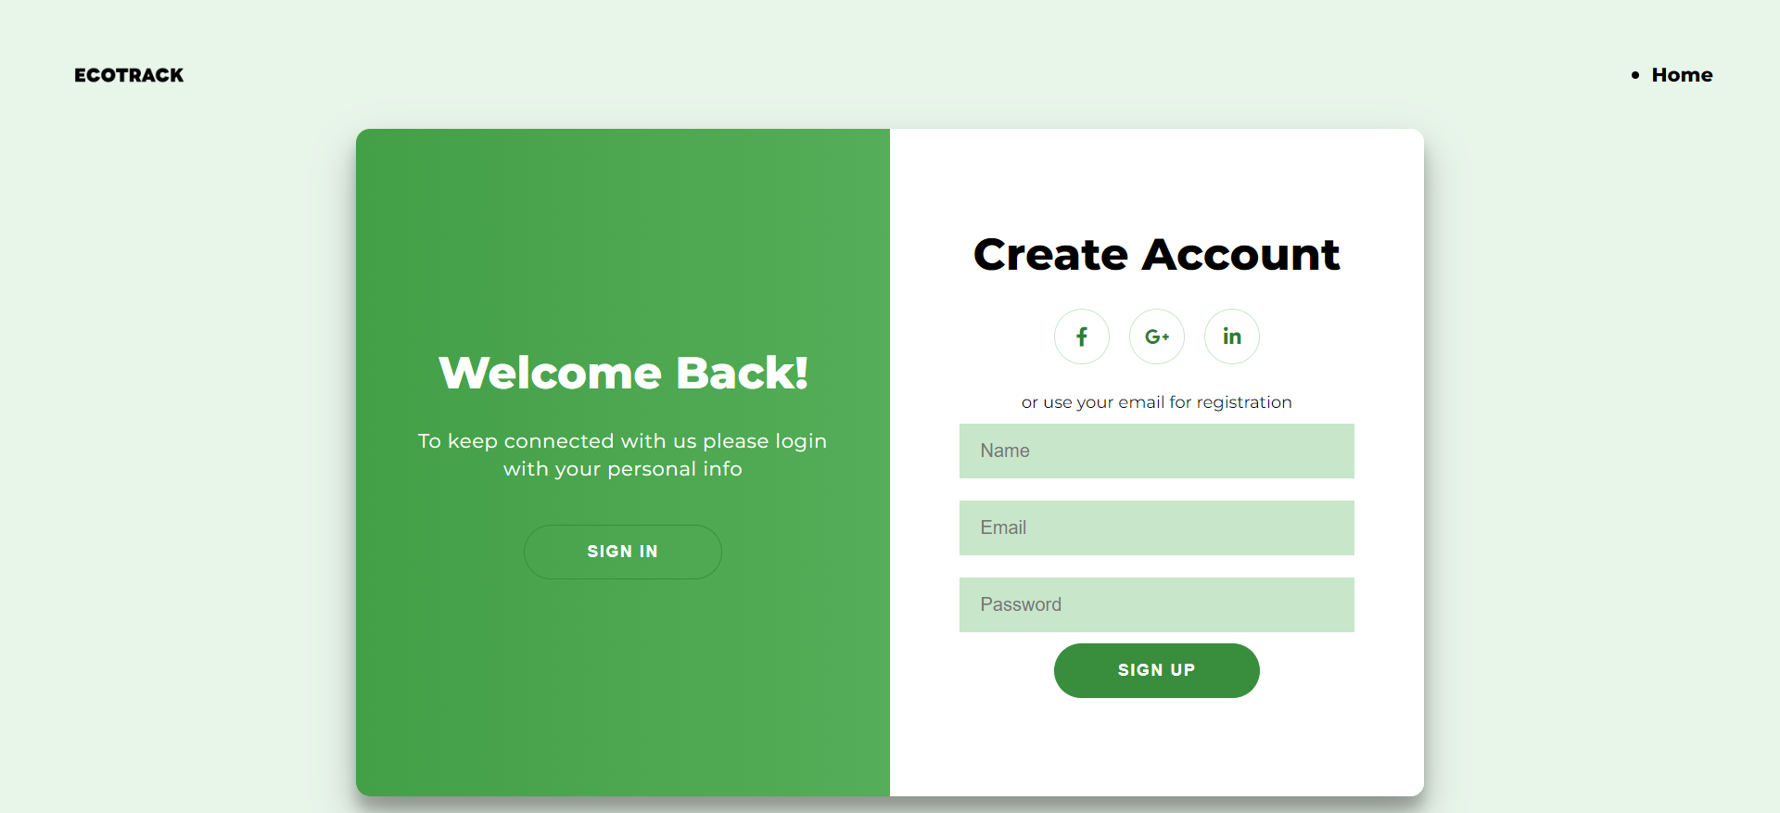
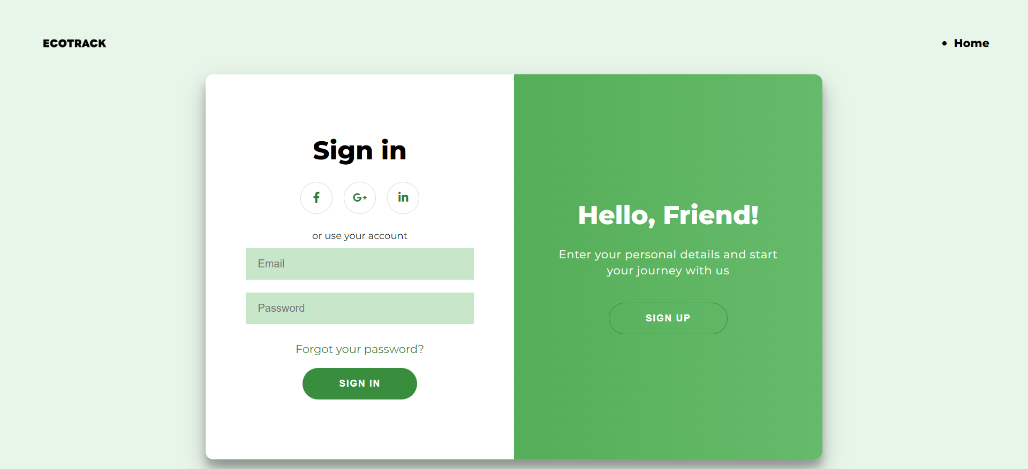
Login page
Login Instructions:
Enter Your Credentials: Provide your username and password to access your account.
Secure Access: Our platform uses advanced encryption to protect your data.
Forgot Your Password? Click the "Forgot Password" link to reset it.
Why Log In?
Enhanced Tracking: Save and review your historical data.
Customized Tips: Get recommendations based on your specific activities and goals.
Goal Setting: Set and monitor personalized sustainability goals.
Engage with the Community: Share your progress and learn from others

Slide 10
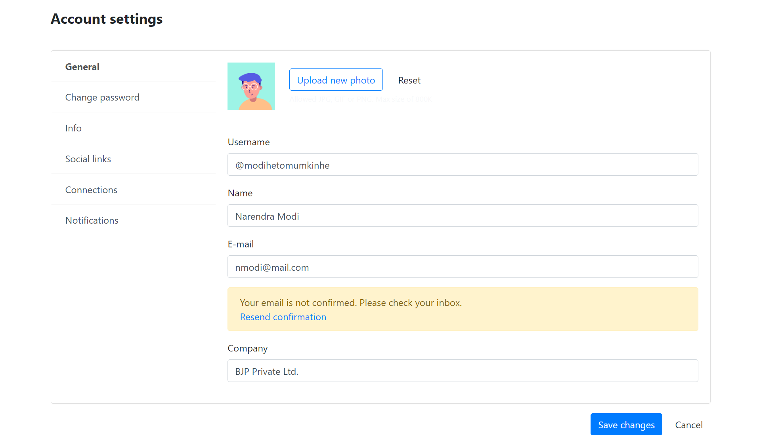
Profile Page
It contains all general information about the user.
It has a notification button receive all new information and news.
Social links helps to connect to all the social media platform like twitter,instagram,facebook.

Slide 11
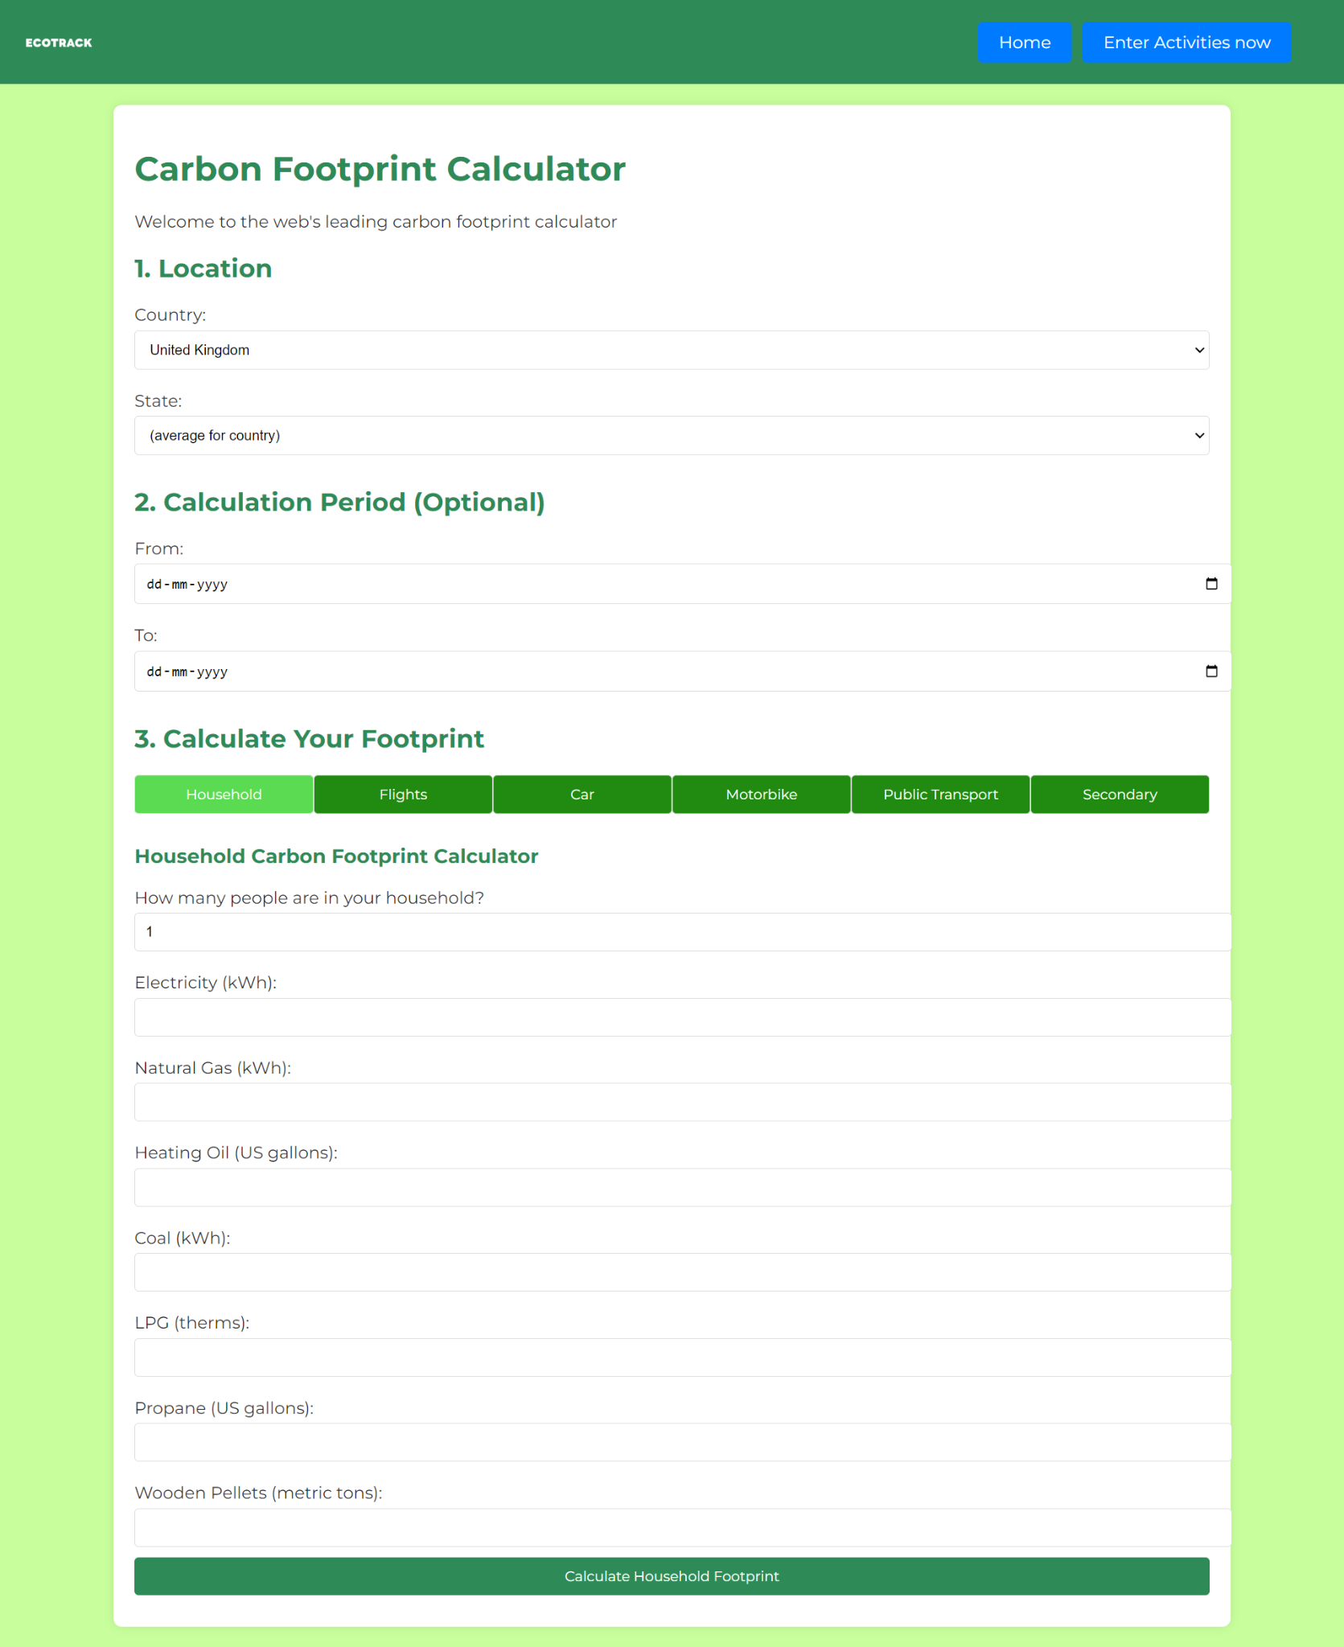
Carbon footprint tracker
A carbon footprint tracker measures carbon emissions from activities like energy use, transportation, and waste.
It helps users understand their environmental impact and identify areas for improvement.

Slide 12
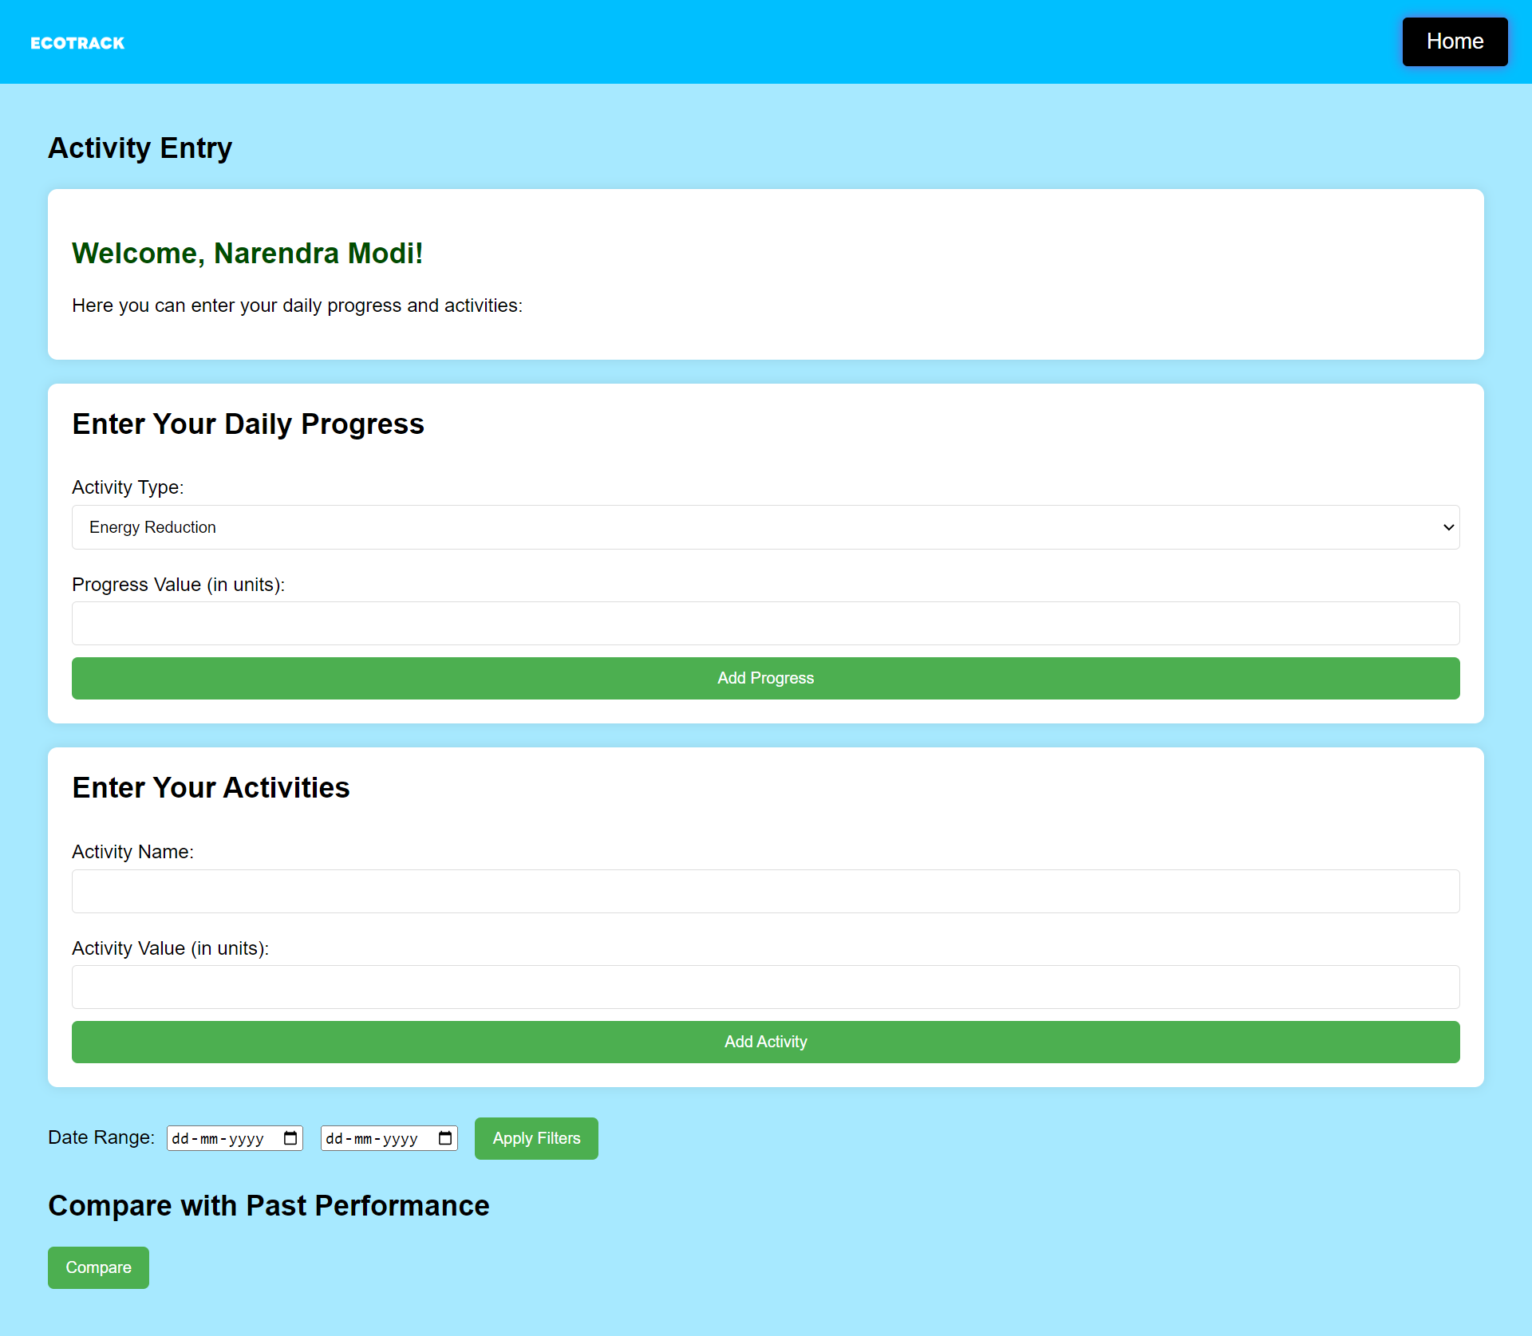
Track Your Activity
The "Track Daily Activity" feature of our Carbon Footprint Tracker empowers you to take control of your environmental impact by logging and analyzing your everyday actions. By recording your daily activities, you can gain valuable insights into how different behaviors contribute to your overall carbon footprint and identify opportunities for improvement.

Slide 13
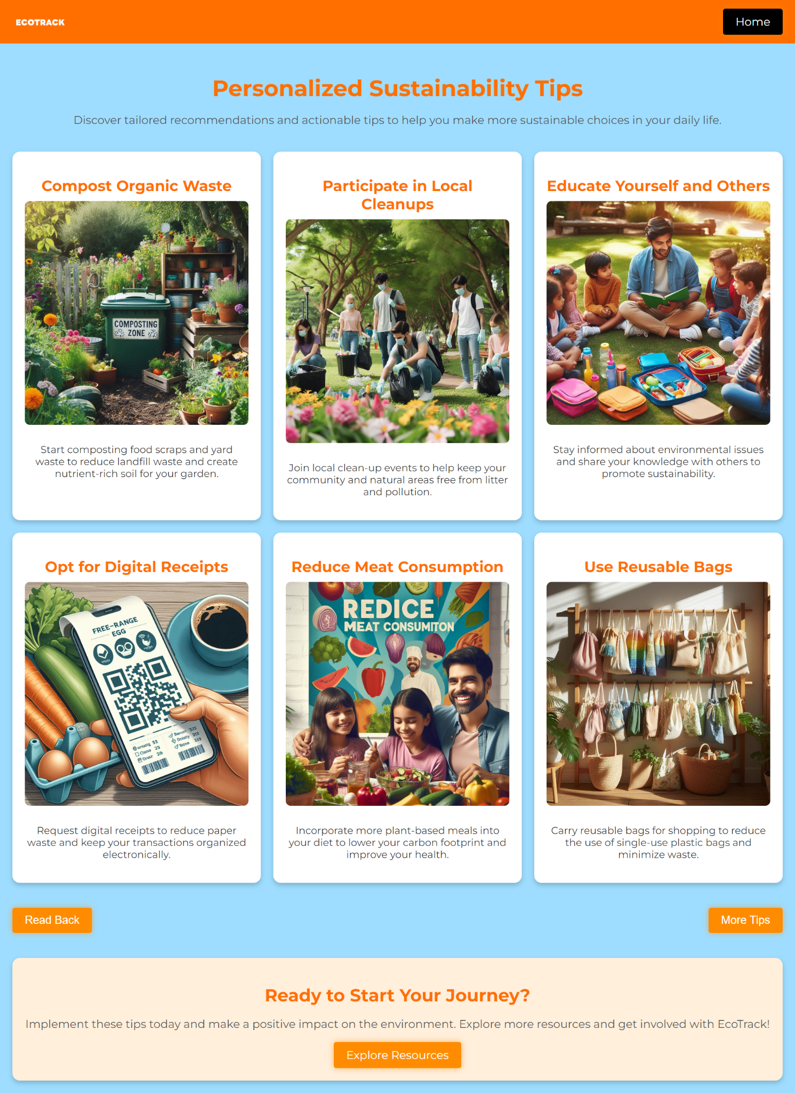
Personalized Sustainability Tips
Provide personalized sustainability tips based on user activities and preferences.
Use machine learning to analyze user data and generate personalized recommendations.

Slide 14
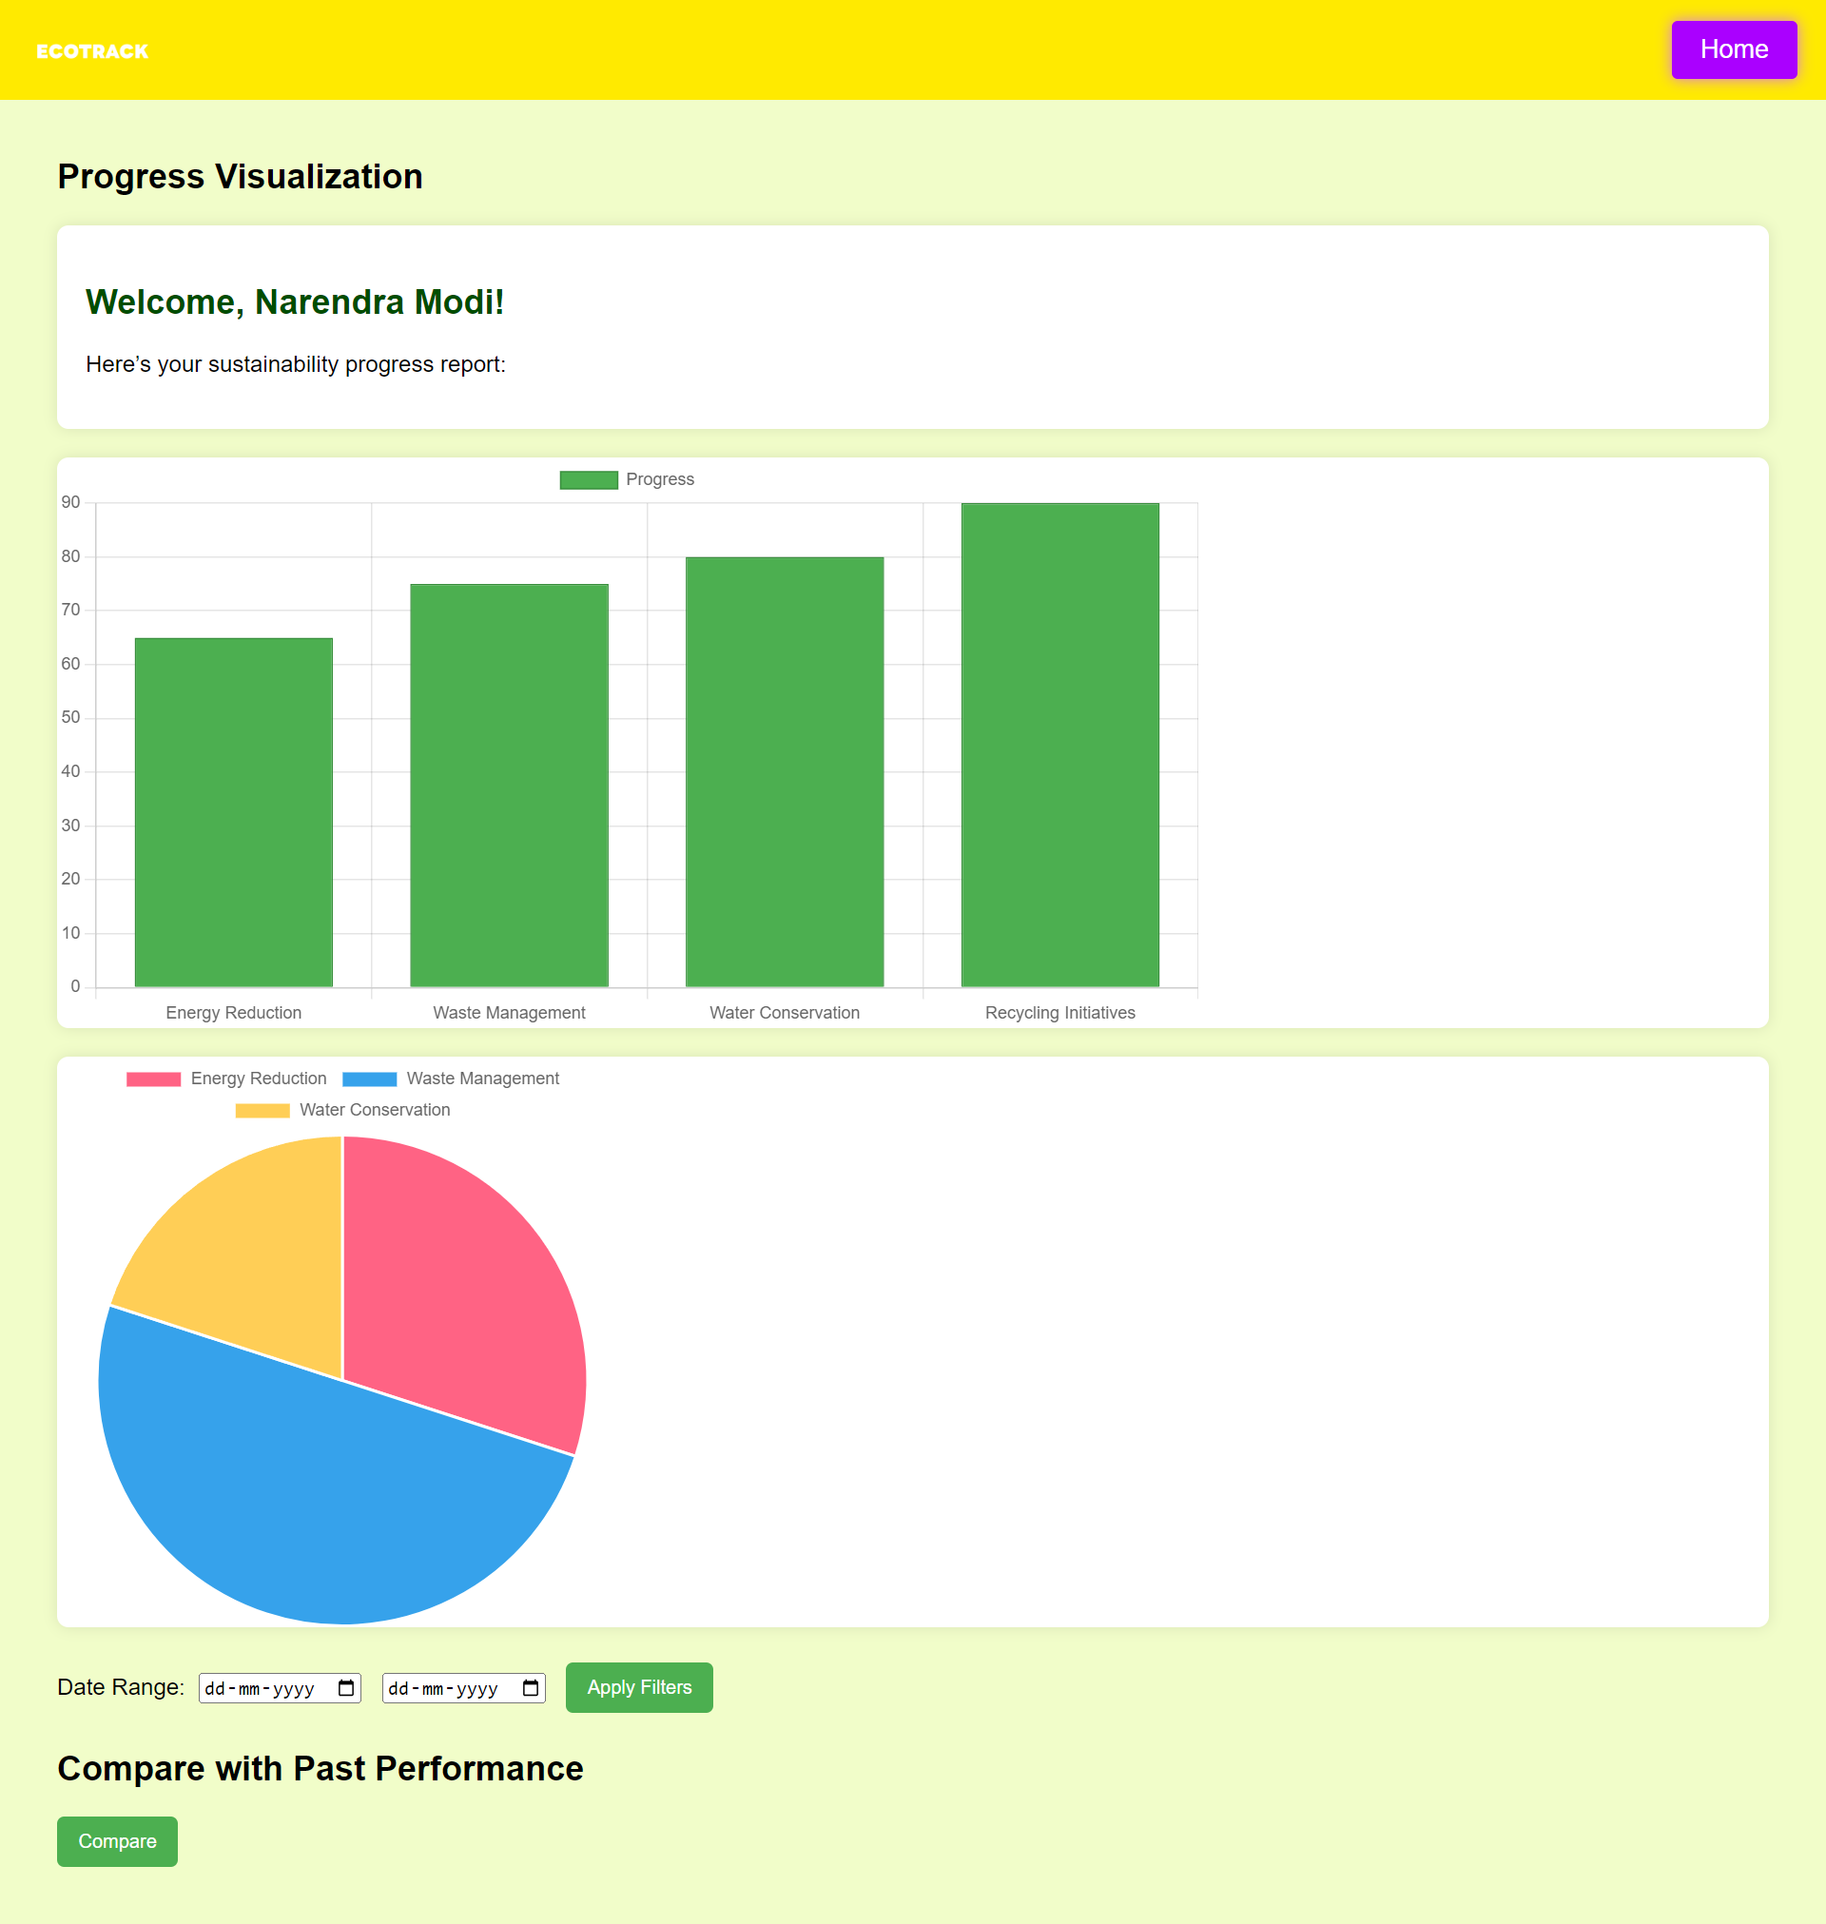
Progress visualization
Use charts and graphs to visualize carbon footprint trends and progress.
Develop interactive dashboards to display carbon footprint data, allowing users to track progress and compare with community benchmarks.

Slide 15
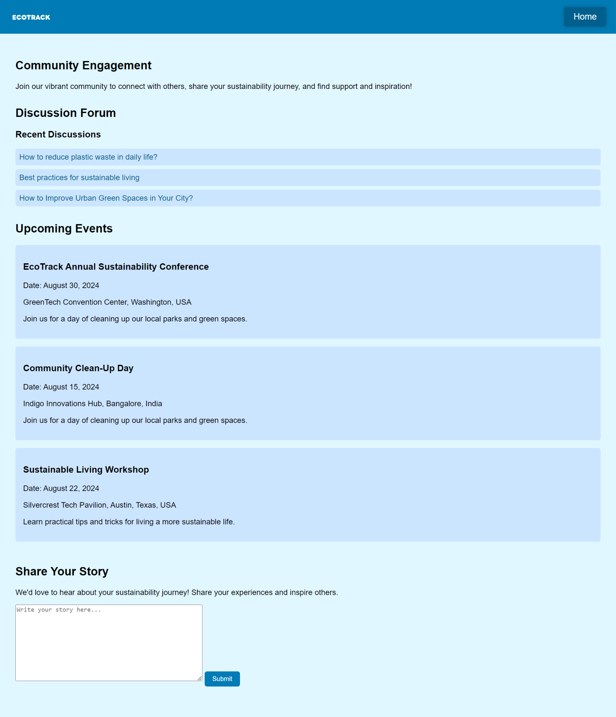
Community engagement
Enable users to connect, share experiences, and collaborate on sustainability projects.
Create a community forum for discussing sustainability, asking questions, and sharing tips
.
Implement moderation to foster a positive and supportive community.

Slide 16
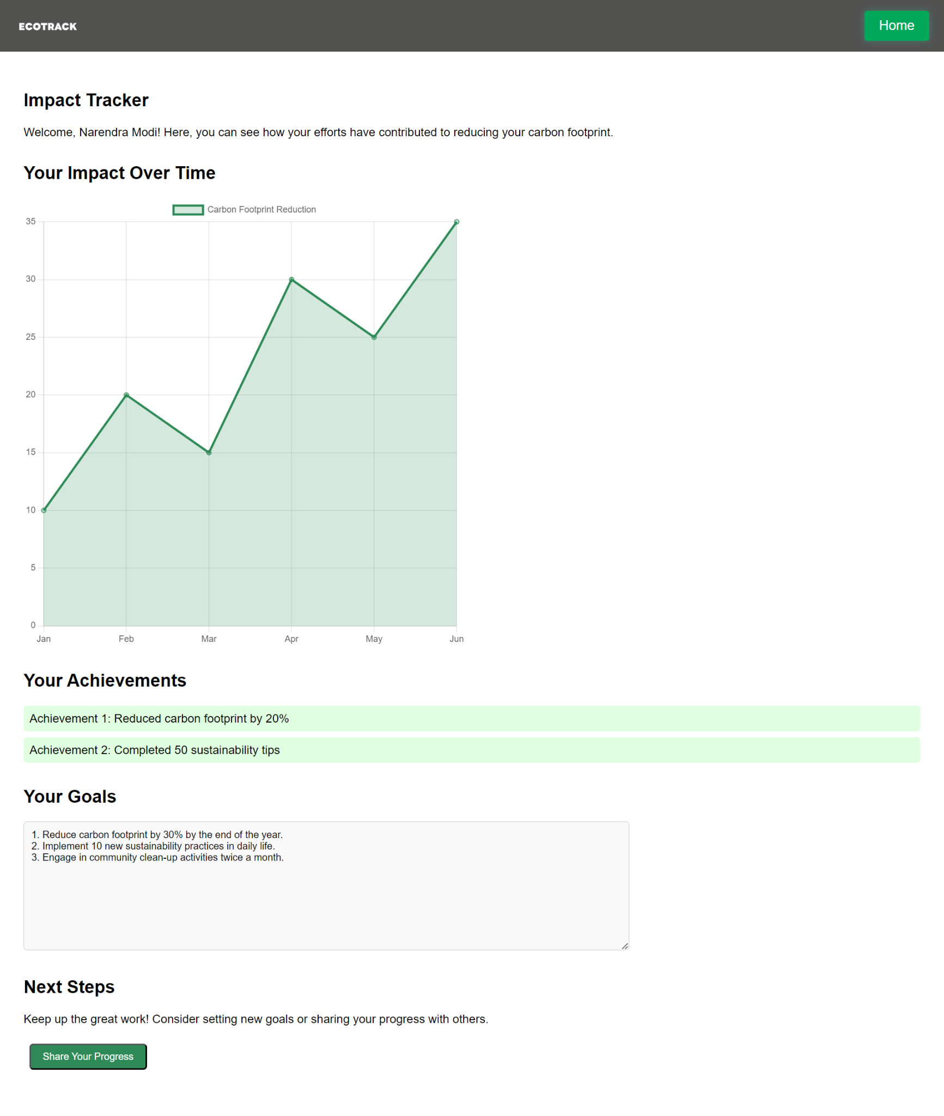
Impact tracker
Develop a tracker that aggregates data to show collective progress.
Highlight success stories and case studies to inspire users.
Show the cumulative environmental impact of individual and community actions.

Slide 17
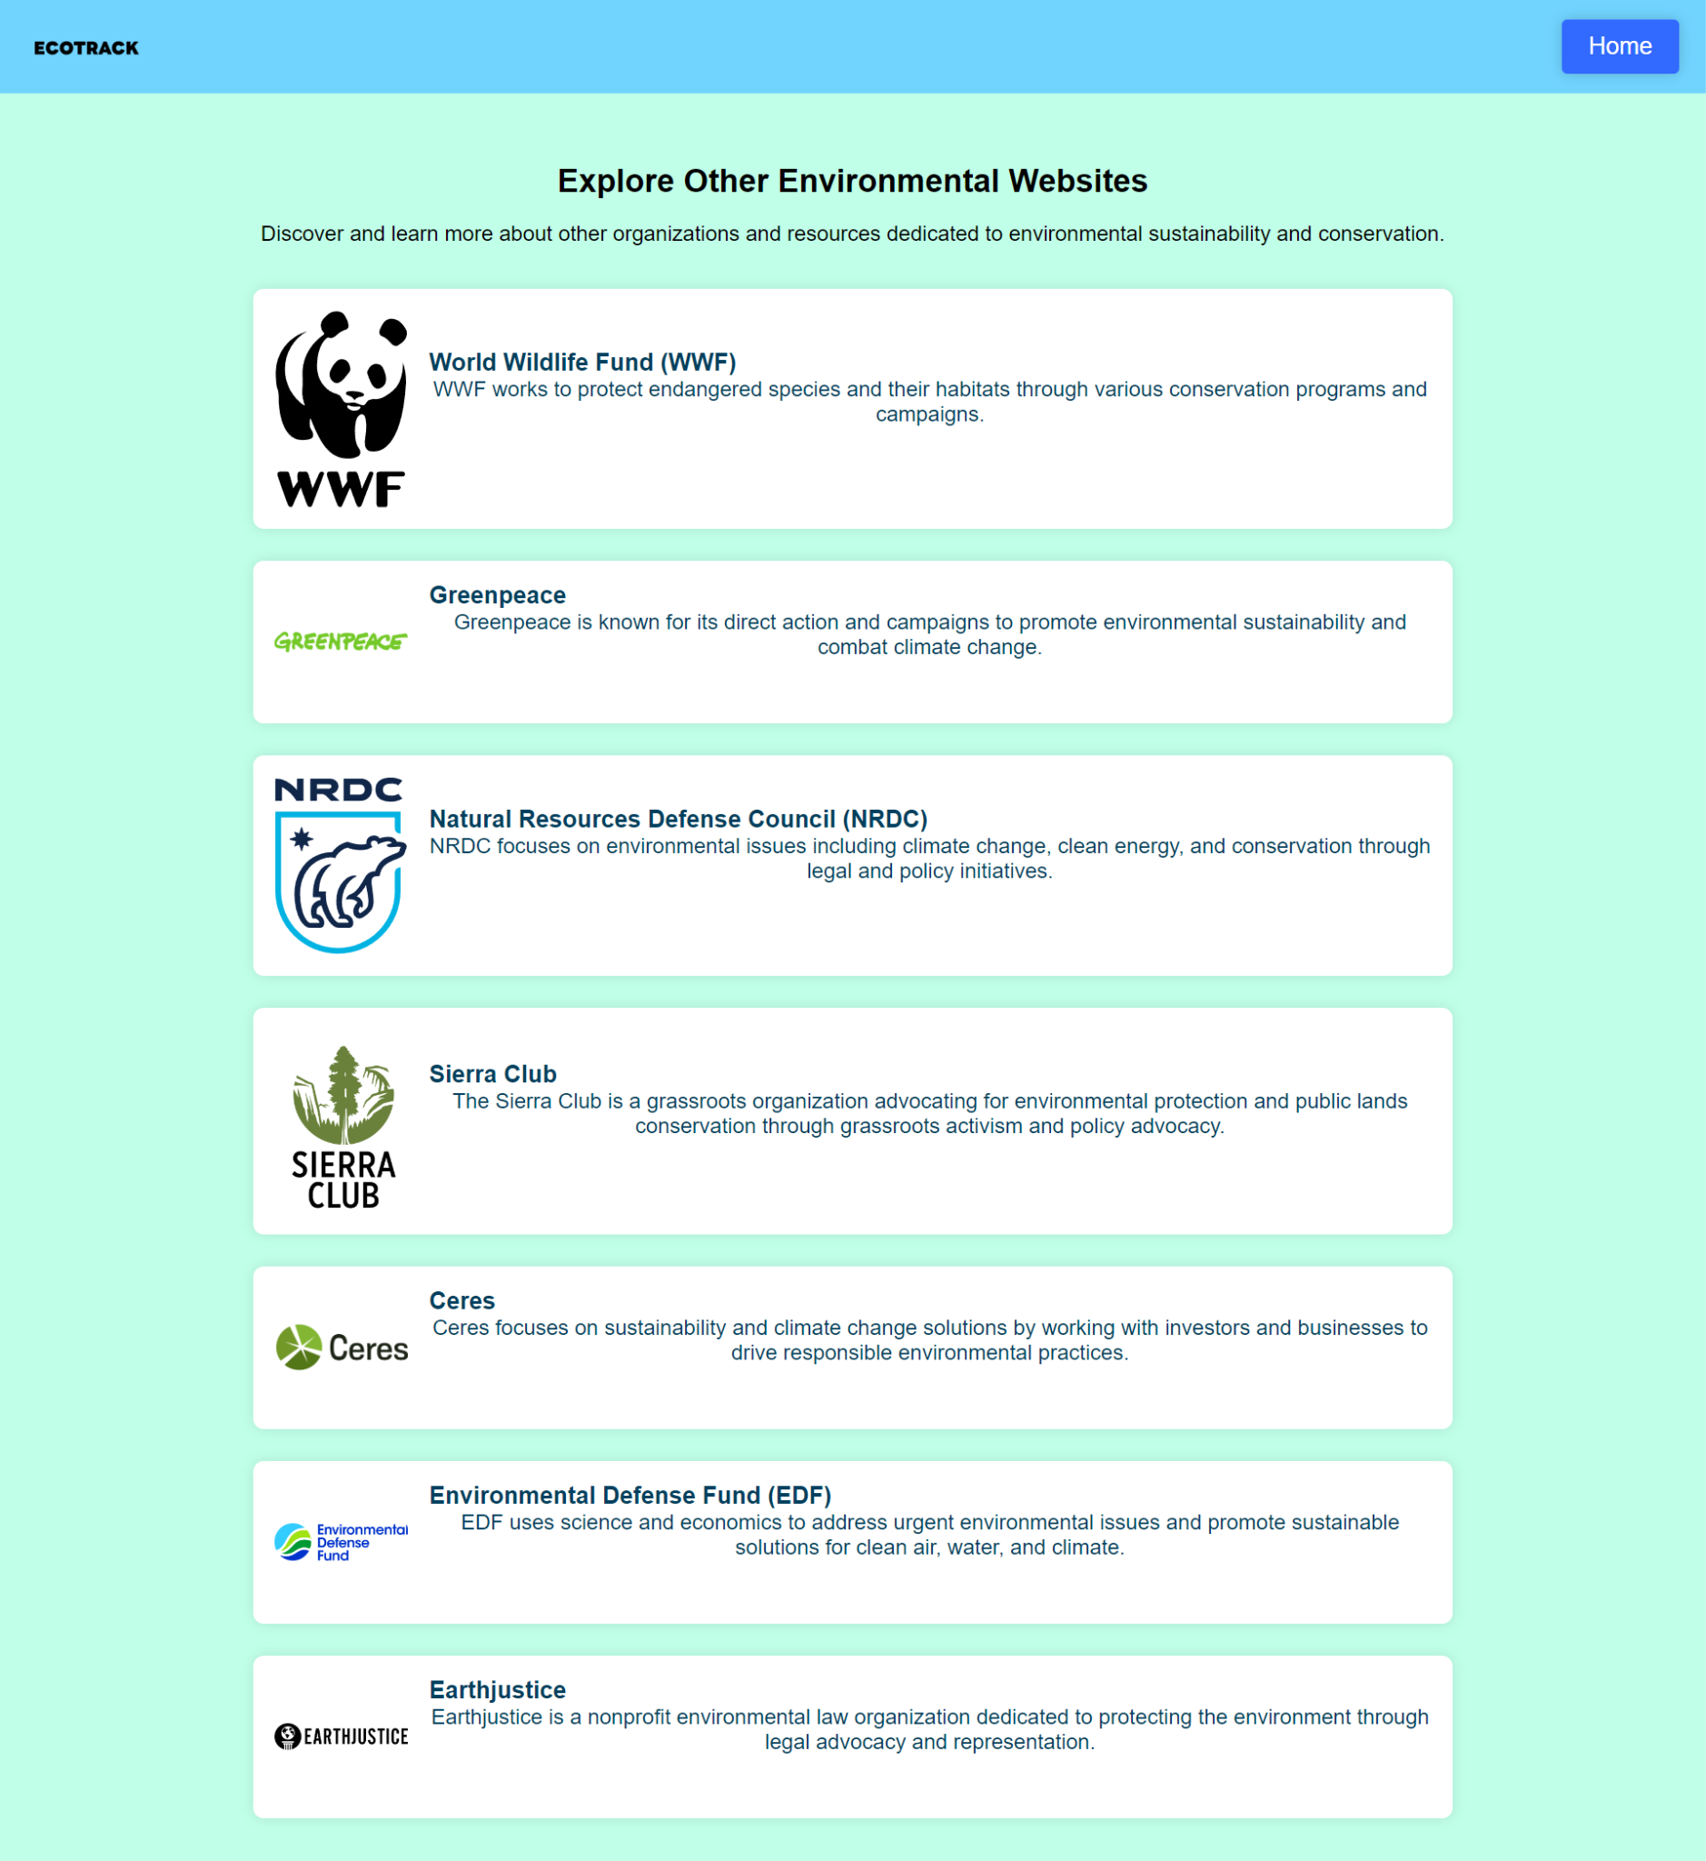
Explore other environmental websites
Each site provides tools, tips, and educational materials for reducing carbon footprints and supporting global sustainability.
Provides insights and recommendations for sustainable living practices to help users lower their carbon emissions.
Features resources and guides on eco-friendly actions and lifestyle changes for carbon footprint reduction.
Offers advice on sustainable living practices and tools to monitor and reduce carbon footprints.

Slide 18
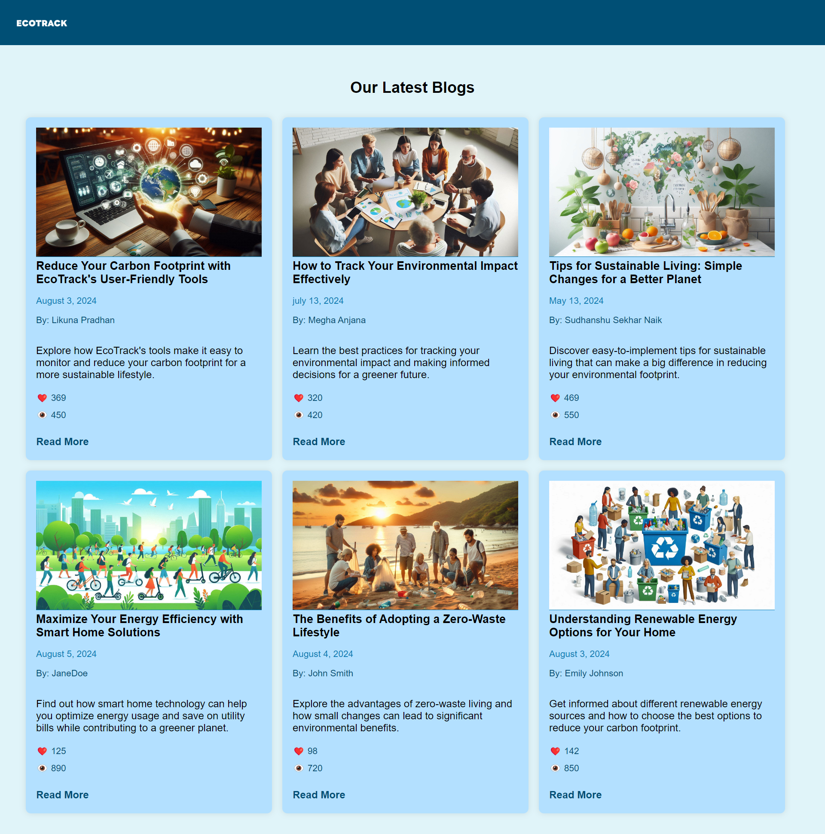
Blogs
Explore our latest blog for insights on carbon footprint reduction, sustainable living, smart home innovations, renewable energy, and more. Discover tips, trends, and strategies to enhance your eco-friendly lifestyle and contribute to a greener future and many more .

Slide 19





Technologies

Slide 20
HOME
SERVICES
EXPLORE OTHER WEBSITE
ABOUT
PORTFOLIO
CARBON FOOTPRINT TRACKER
FAQS
OUR MISSION
Team members
PERSONALIZED SUSTAINABILITY TIPS
OUR VISION
PROGRESS VISUALIZATION
ROLES
OUR JOURNEY
COMMUNITY ENGAGEMENT
KEY ACHIEVEMENT
THANK YOU
IMPACT TRACKER

Slide 21
THANK YOU
FROM, TEAM ML HATS

